Slide 1
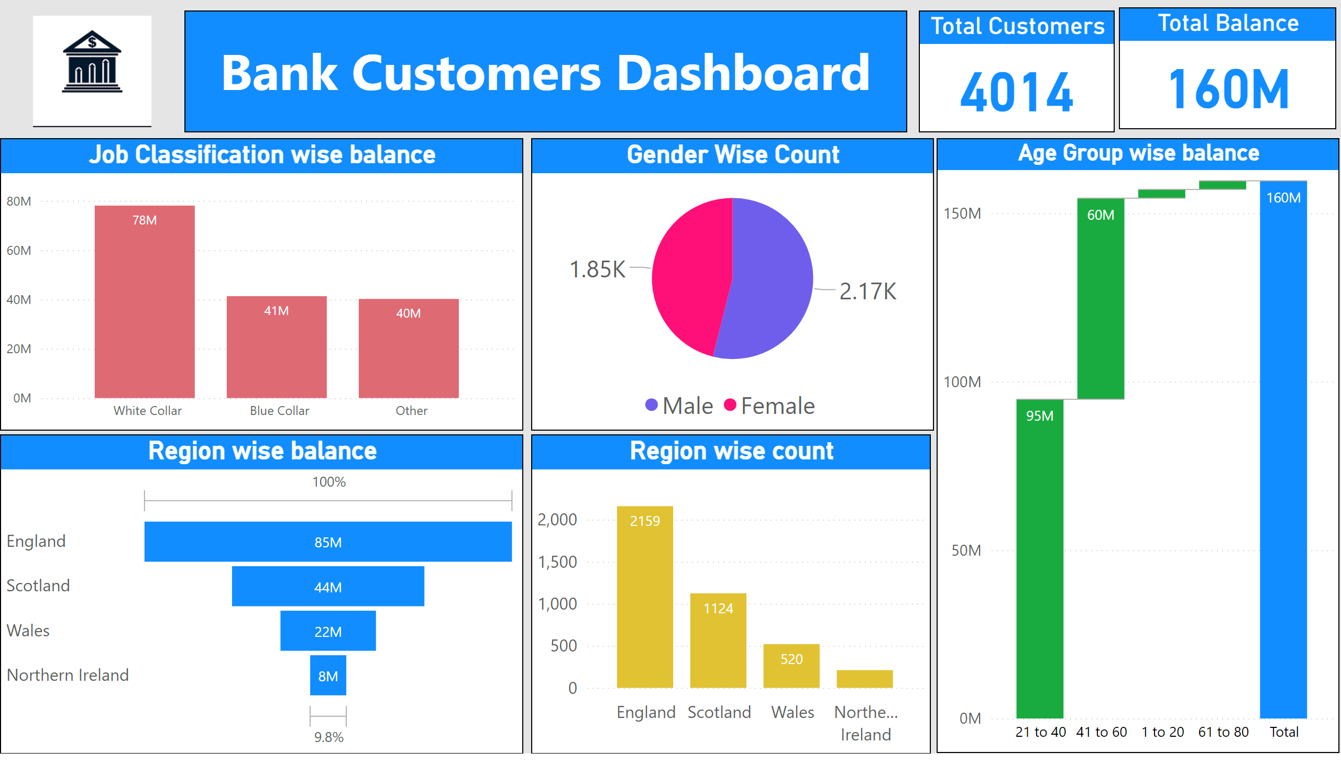
Dashboard
Notes:
Notes :-
Female had total count 1.85 thousand out of 4.02 thousand and rest were Male
At 78.01 Million, White Collar had the highest total Balance and was 94.08% higher than Other, which had the lowest total Balance at 40.22 Million.﻿
White Collar had the highest total Balance at 78.01 Million, followed by Blue Collar at 41.33 Million and Other at 40.22 Million.
White Collar accounted for 48.91% of total Balance.
﻿White Collar had 78.01 Million total Balance, Blue Collar had 41.33 Million, and Other had 40.22 Million.

Slide 2
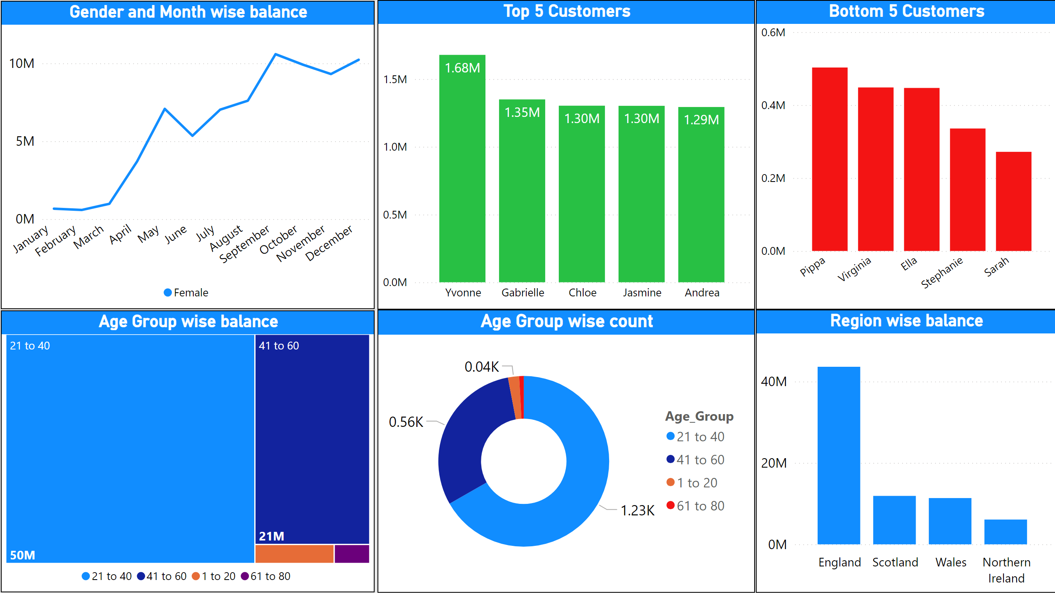
Summary
Notes:
Notes :-
At 1.68 Million, Yvonne had the highest total Balance and was 29.74% higher than Andrea, which had the lowest total Balance at 1.29 Million.﻿
﻿Yvonne accounted for 24.23% of total Balance.
Across all 5 Name, total Balance ranged from 1.29 Million to 1.68 Million.
Total Balance trended up, resulting in a 1,433.31% increase between January 2015 and December 2015.﻿
Total Balance for Female started trending up on January 2015, rising by 1,433.31% (9.56 Million) in 11 months.﻿

